Slide 1

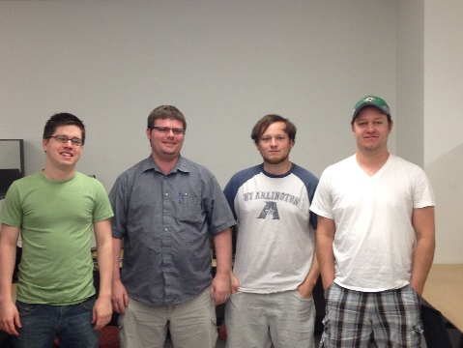
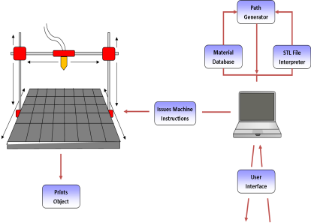
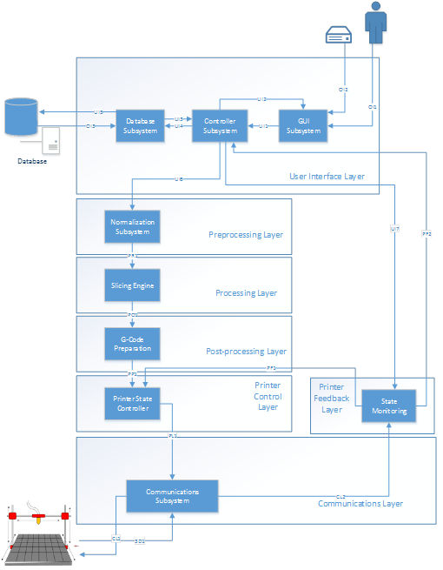
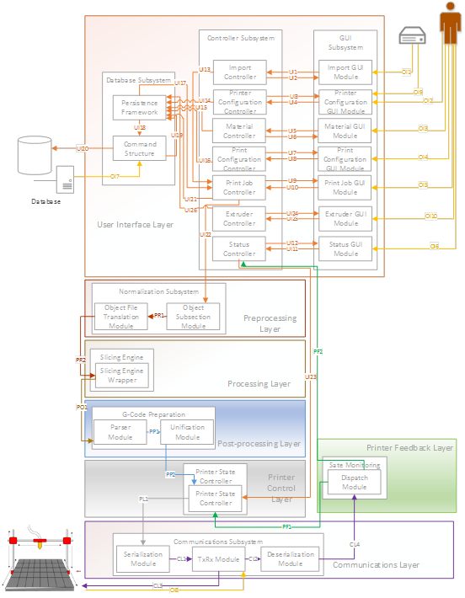
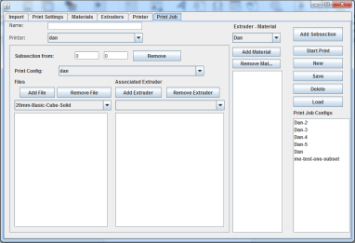
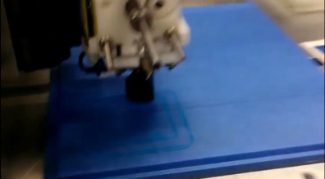
3D Printer Fabrication System
Team Ink3D
Design Concept
Architecture
Critical Requirements
3.1 STL File Input | Completed
3.2 Graphical User Interface | Completed
3.3 Generate Machine Instructions | Completed
3.4 Issue Machine Instructions | Completed
3.5 Monitor Temperature | Completed
3.6 Monitor Position | Completed
3.7 Adhere to Material Constraints | Completed
3.8 Identify Materials | Completed
3.9 Identify Shapes | Completed
3.10 Determine Shape of Support Material Structure | Completed
3.11 Create Printing Path | Completed
3.12 Database Interface | Completed
3.13 Store & Load Material Records | Completed
3.14 Slice Geometry into Thickness Levels | Completed
3.15 Monitor Flow Sensors | Completed
3.17 Allow for UV Head Polymerization | Completed
Role | Assigned To | Responsibility
Project Manager | Daniel Lain | Maintain Project Plan Assign Tasks to Team Turn in Deliverables Risk Manager Change Approval
Hardware Lead | Shawn Simonson | Plan Hardware Interfaces Research Hardware Hardware Development ME Liaison Change Approval
Software Engineering Lead | Jesse Bowles | System Architecture Modular Planning Scalability Planning Develop UMLs Change Approval
Lead Programmer | Tim Edmonson | Algorithm Development Open Source Selection Algorithm Research Change Approval
Product Description
The 3-D Printer Fabrication System will provide an interface for converting standard stereo lithography or STL files into realized items. The system will use a simple graphical user interface to select the files and materials to be used in the production of the 3D model. When a file is loaded, the system will translate the STL file in to a series of layers based on the granularity of the materials to be used in the final build. The system will then use the layers to produce a series of paths for the print head to traverse to deposit the correct material to the specified location. From this series of steps, an instruction set will be produced for the printer to execute each path for every layer and material. Finally, the instructions will be issued to the printer and it will execute the commands producing the designed object that was described by the original STL files.
Detailed Design
Prototype
System Test Plan
Lessons Learned
Understand the customer’s needs
Constant communication with team and customer
Ask for help when needed
Hold each other accountable
Design in as much detail as possible before implementation
Use resources available

Slide 2
Architecture
Design Concept
Prototype
Architecture
Product Description
System Test Plan

Slide 3
Critical Requirements
3.1 STL File Input | Completed
3.4 Issue Machine Instructions | Completed
3.5 Monitor Temperature | Completed
3.6 Monitor Position | Completed
3.8 Identify Materials | Completed
3.9 Identify Shapes | Completed
3.10 Determine Shape of Support Material Structure | Completed
3.11 Create Printing Path | Completed
3.14 Geometry Slicing | Completed
3.17 Allow for UV Head Polymerization | Completed

Slide 4
Critical Requirements
3.1 STL File Input | Completed
3.2 Graphical User Interface | Completed
3.3 Generate Machine Instructions | Completed
3.4 Issue Machine Instructions | Completed
3.5 Monitor Temperature | Completed
3.6 Monitor Position | Completed
3.7 Adhere to Material Constraints | Completed
3.8 Identify Materials | Completed
3.9 Identify Shapes | Completed
3.10 Determine Shape of Support Material Structure | Completed
3.11 Create Printing Path | Completed
3.12 Database Interface | Completed
3.13 Store & Load Material Records | Completed
3.14 Slice Geometry into Thickness Levels | Completed
3.15 Monitor Flow Sensors | Completed
3.17 Allow for UV Head Polymerization | Completed

Slide 5
Lessons Learned
Understand the customer’s needs
Constant communication with team and customer
Ask for help when needed
Hold each other accountable
Design in as much detail as possible before implementation
Use resources available

